Slide 1
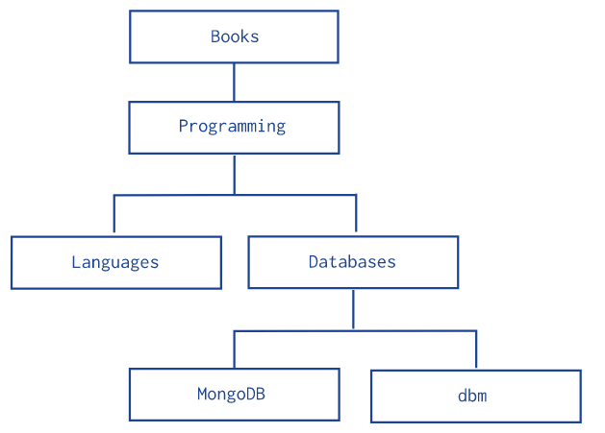
Model Tree Structures with Child References
This page describes a data model that describes a tree-like structure in MongoDB documents by storing references in the parent-nodes to children nodes.
The Child References pattern stores each tree node in a document; in addition to the tree node, document stores in an array the id(s) of the node’s children.
Hierarchy of Categories
The following example models the tree using Child References, storing the reference to the node’s children in the field children:
db.categories.insertMany( [
{ _id: "MongoDB", children: [] },
{ _id: "dbm", children: [] },
{ _id: "Databases", children: [ "MongoDB", "dbm" ] },
{ _id: "Languages", children: [] },
{ _id: "Programming", children: [ "Databases", "Languages" ] },
{ _id: "Books", children: [ "Programming" ] }
] )

Slide 2
Model Tree Structures with Child References
db.categories.findOne( { _id: "Databases" } ).children
db.categories.createIndex( { children: 1 } )
db.categories.find( { children: "MongoDB" } )

Slide 3
Data Modelling in MongoDB
https://docs.mongodb.com/manual/tutorial/model-embedded-one-to-one-relationships-between-documents/

